Slide 1
Design and Manufacturing
Commercial Furniture
in Australia.
An Introduction to Manufacturing and Design through a local lens

Slide 2
Lesson objectives
OVERVIEW
By the end of this lesson, you will be able to:
Understand the basics of product features
Understand the basics of various production methods
Interpret technical drawings used in manufacturing
Select manufacturing methods based on features and context
ACTIVITIES
What makes one chair different from the next?
Local manufacturing processes
Interpret drawings
Reverse engineering furniture designs
RESOURCES
Slide deck (with videos)
Worksheet
Sample production drawings

Slide 3
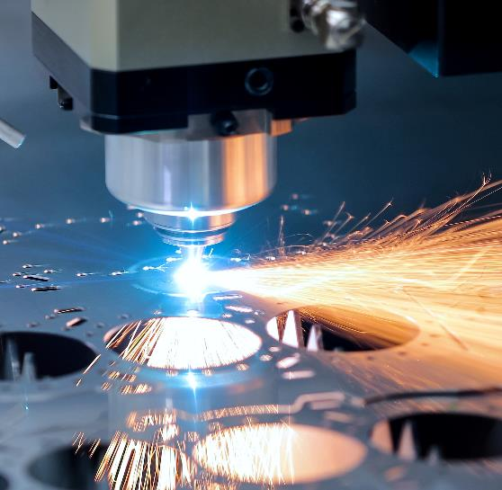
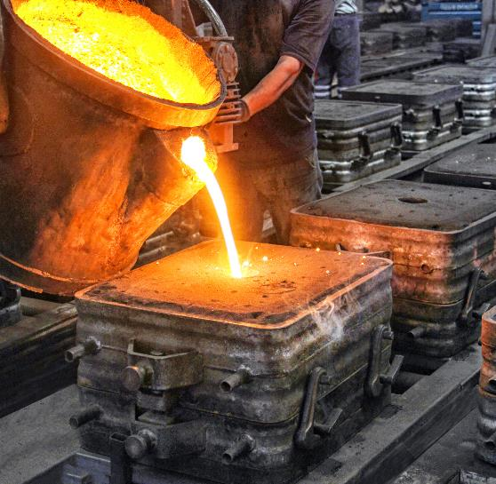
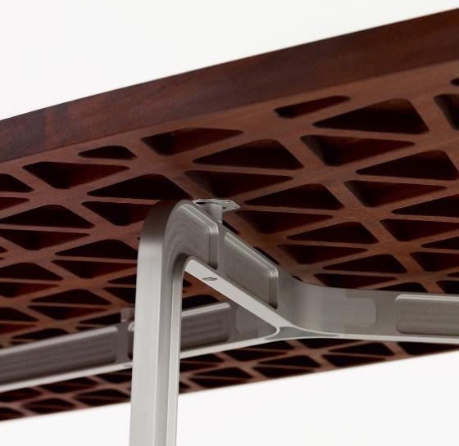
Furniture manufacturing
INTRODUCTION
In this lesson, we’ll learn about manufacturing processes through the lens of furniture design and manufacturing in Australia

Slide 4
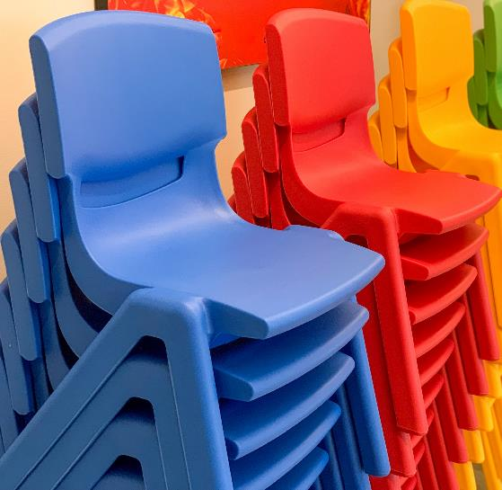
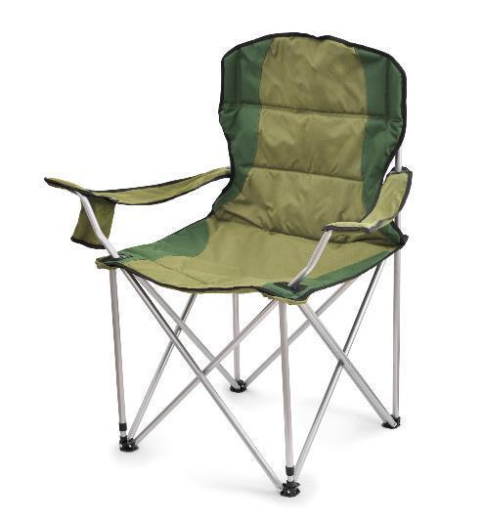
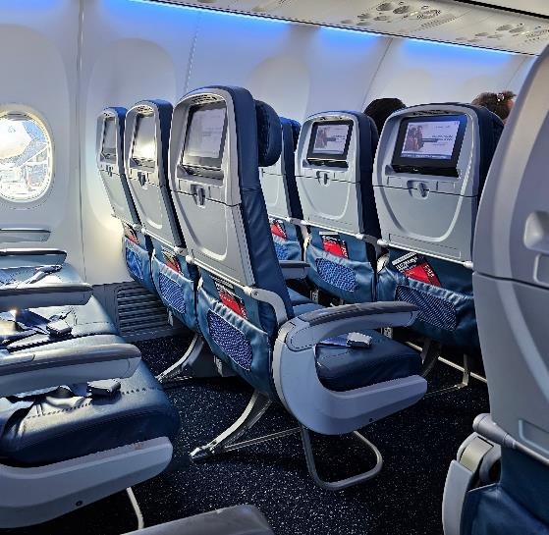
What makes one chair different from the next?
ACTIVITY
Everybody sits! You’re probably sitting right now, but what makes one chair different to another?

Slide 5
WHAT MAKES ONE CHAIR DIFFERENT FROM THE NEXT?
For each chair, think about and make some notes on the following:
What are its functions and features beyond just being sat on?
What do you notice about its appearance and assembly?
Can you can identify any similarities or differences?
Plastic stacking chair
Camping chair
Aeroplane Seat

Slide 6
WHAT MAKES ONE CHAIR DIFFERENT FROM THE NEXT?
Stackable
One piece, one shot plastic construction, means no assembly keeping costs down
Weather resistant, can be used inside or out
Ideally foldable yet comfortable
Should be durable and resistant to sun and rain
Should be easy enough for anyone to understand how to unfold on their own
Comfort, safety, entertainment, dining, storage and more
Complex assembly of high precision parts needs to be strong and light at the same time

Slide 7
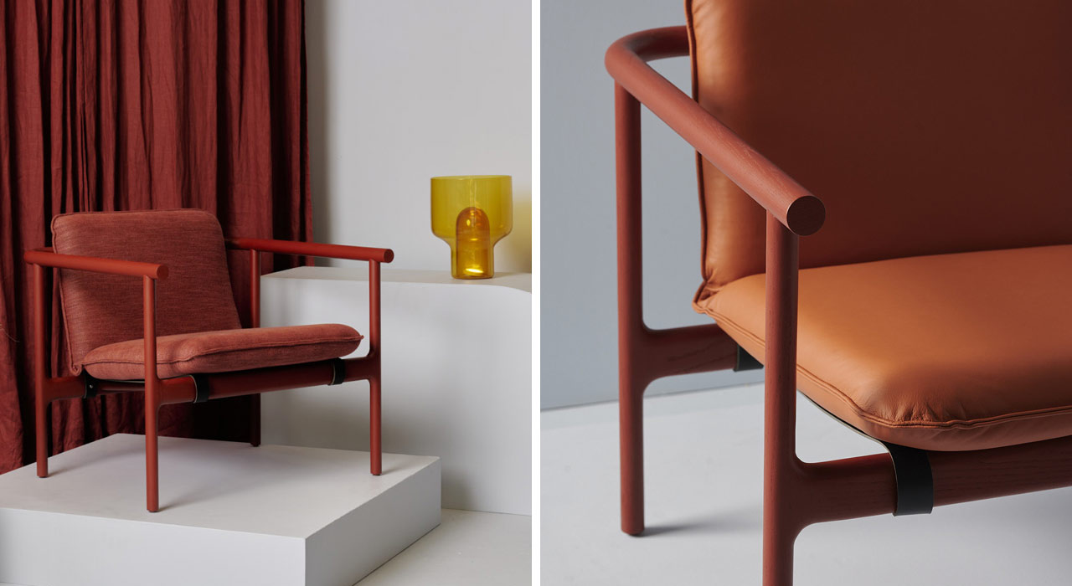
Local manufacturing processes
How can accessible manufacturing methods be exploited to make beautiful and practical furniture?
Here are five commonly used processes, with examples from Australian Designers.
ACTIVITY
Hoshi Chair by Tom Skeehan

Slide 8
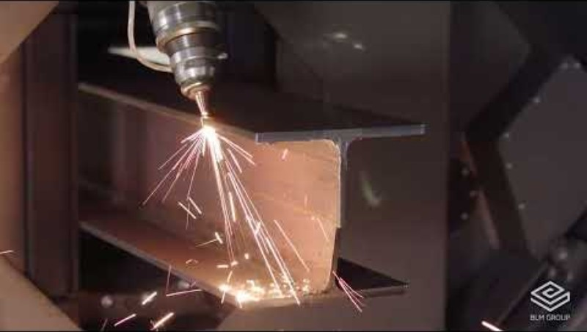
Machining metal
MANUFACTURING PROCESSES
Great for precision
Suits high and low quantities
Can make very complex parts
Beam CNC laser cutting machine

Slide 9
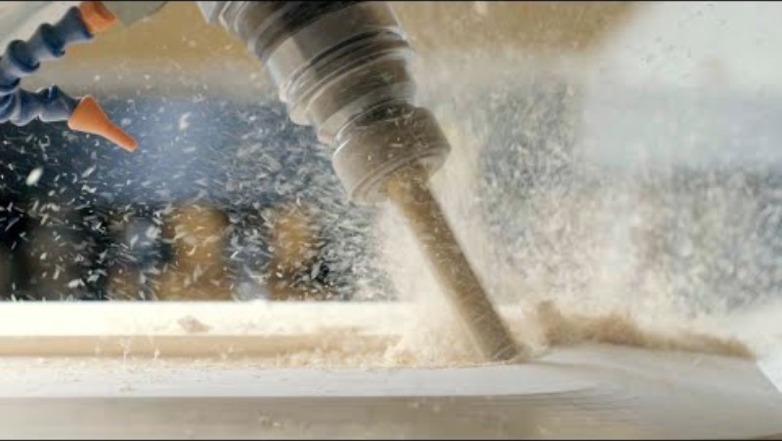
Machining Timber
MANUFACTURING PROCESSES
Great for complex geometric shapes that can’t be made with traditional woodworking methods
Consistent accuracy across many parts
Still requires the knowledge of a craftsperson
Manufacturing and machining timber

Slide 10
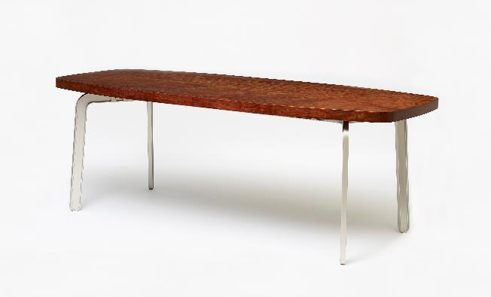
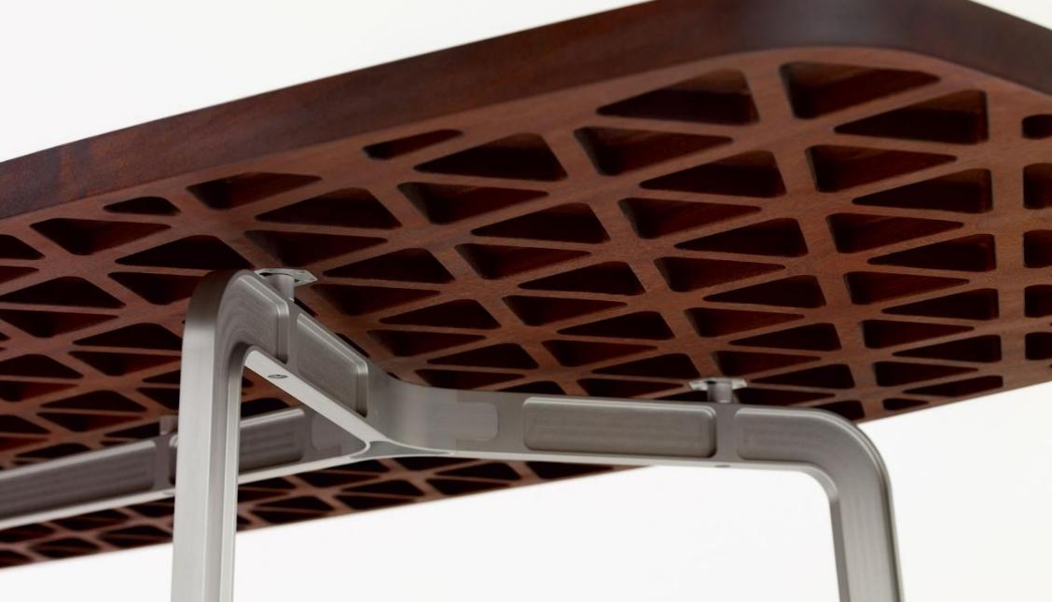
‘Hex’ Table by Marc Newson
MANUFACTURING PROCESSES
The top (timber) and the legs (aluminium) are all made by machining

Slide 11
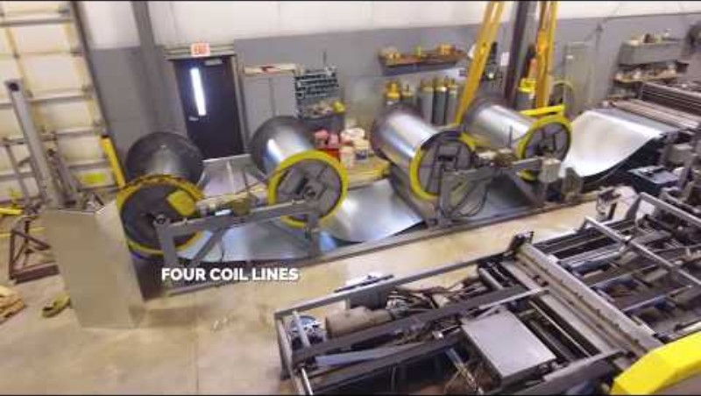
Sheet metal fabrication
MANUFACTURING PROCESSES
Computer-controlled precision
Suits high and low quantities
Has a distinct look
Sheet metal fabrication in the spotlight

Slide 12
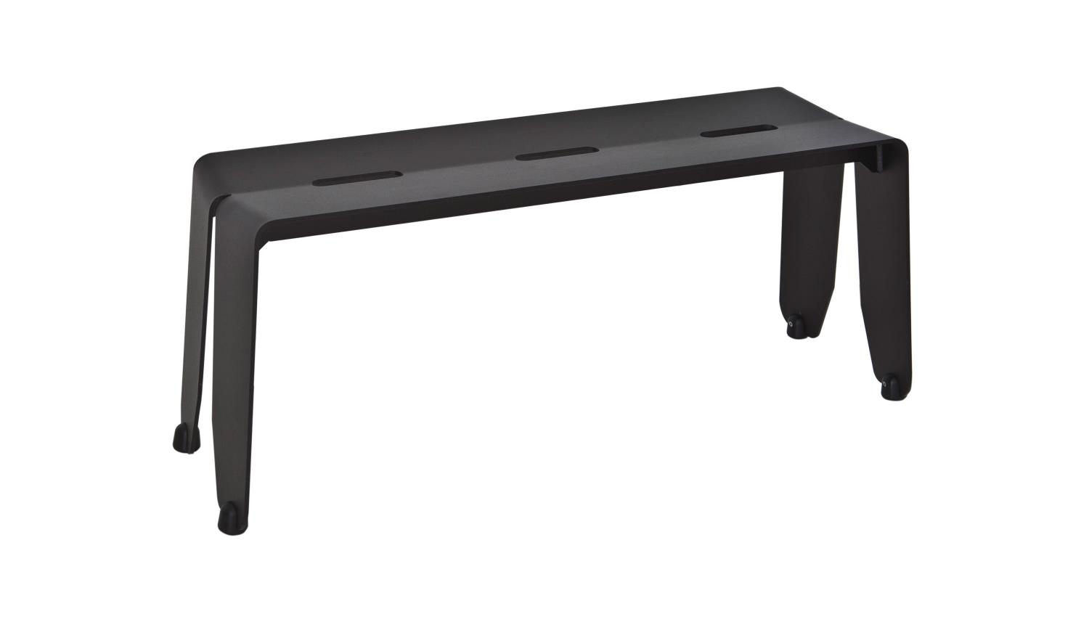
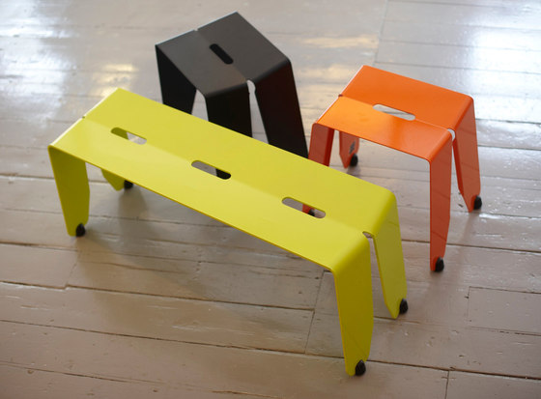
‘Brainwash’ bench and table range by Jason Bird
MANUFACTURING PROCESSES
Complete sheet metal bench: laser cut, folded and welded with machined plastic feet

Slide 13
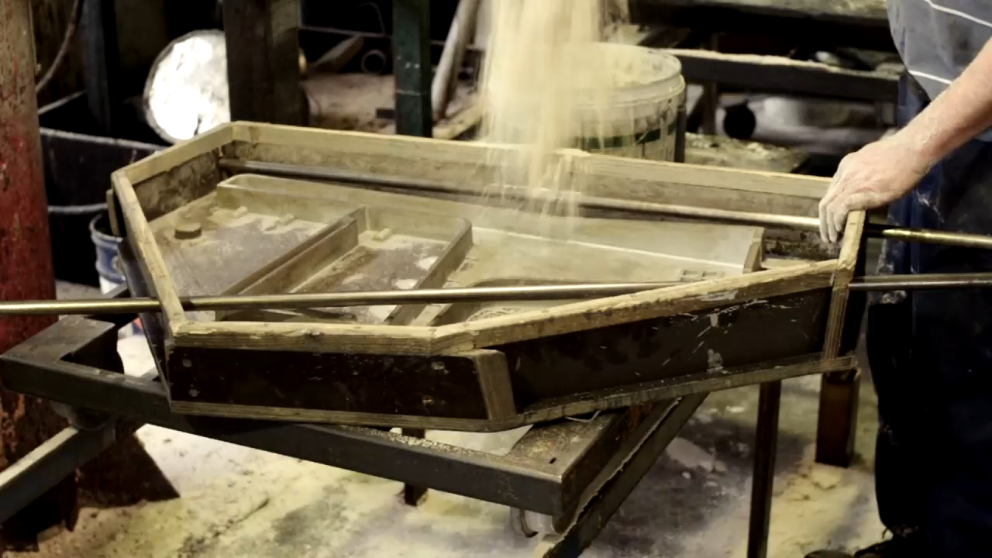
Sand casting
MANUFACTURING PROCESSES
Good for solid chunky parts
Low-tech
Not very accurate
Often requires additional finishing
A sand casting factory formerly located in North Brisbane

Slide 14
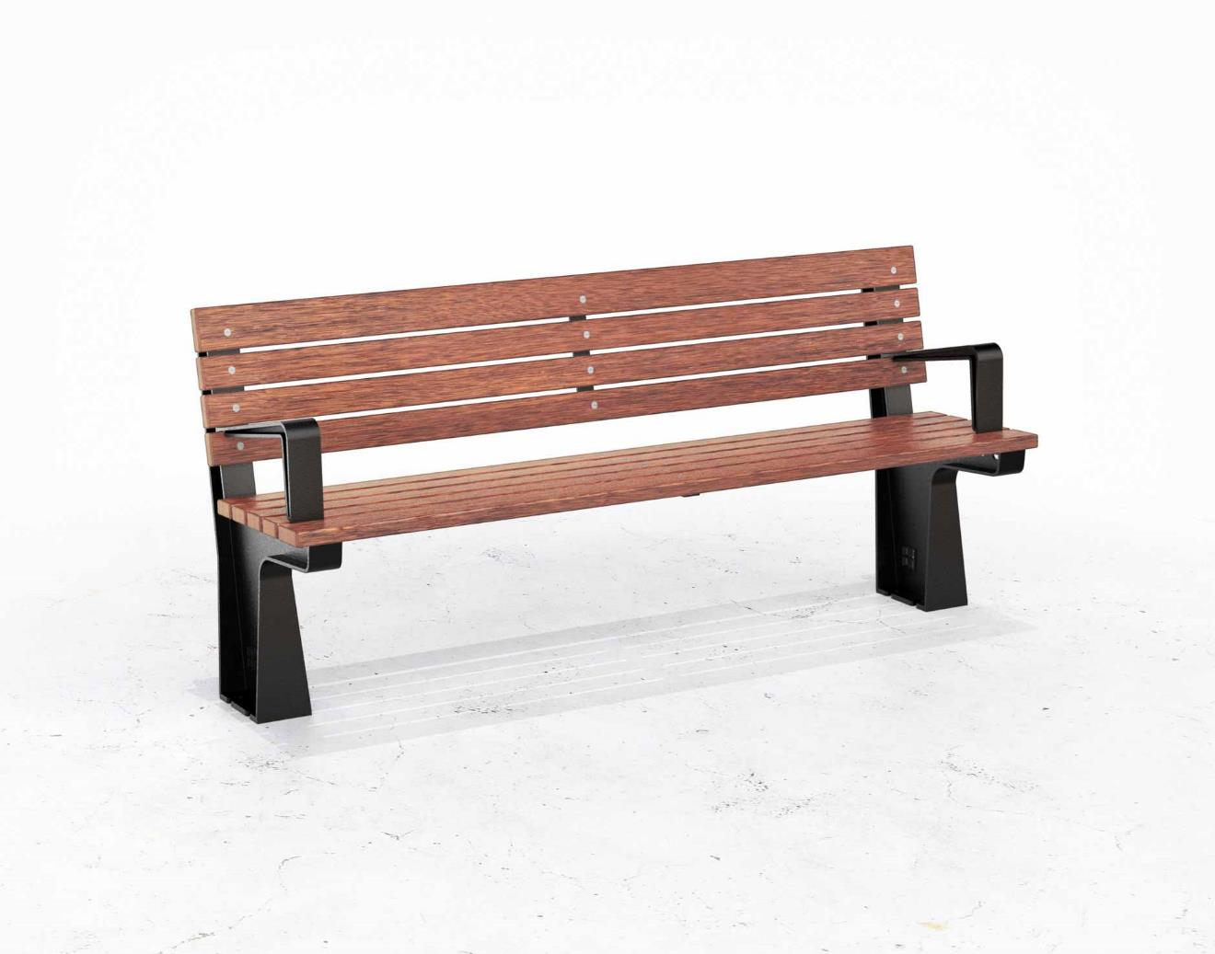
‘Lakes’ bench by David Shaw & Surya Graf
MANUFACTURING PROCESSES
Sand cast aluminium frame with solid timber slats

Slide 15
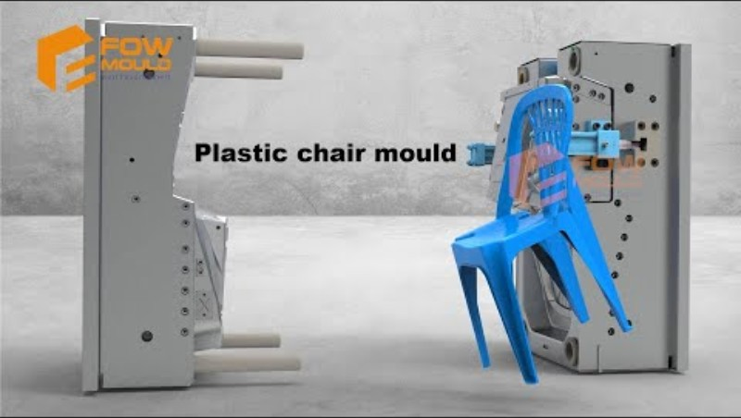
Injection moulding
MANUFACTURING PROCESSES
Can produce many parts quickly and in a cost effective way
Excellent precision
Moulds are expensive
Injection moulding a stacking plastic chair

Slide 16
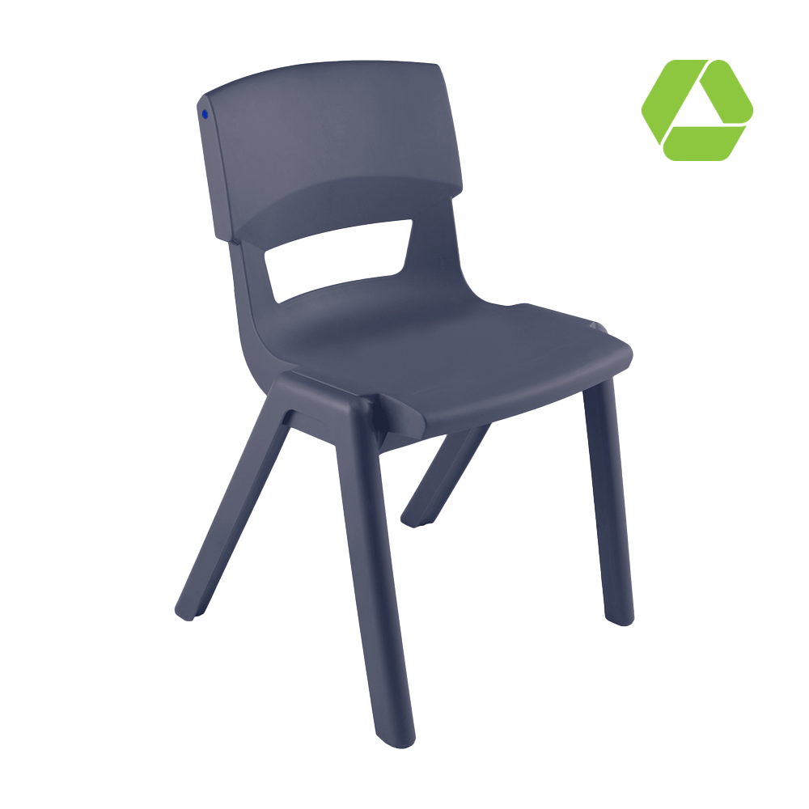
‘Postura max’ stacking chair by Sebel furniture
MANUFACTURING PROCESSES
Australian–made, single piece injection moulded chair made from recycled plastic

Slide 17
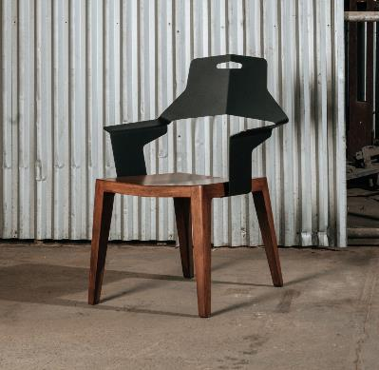
Interpret drawings
ACTIVITY
Look at the set of drawings provided and make some notes on the processes you would use to make these parts.
What are some other things you notice about these drawings?

Slide 18
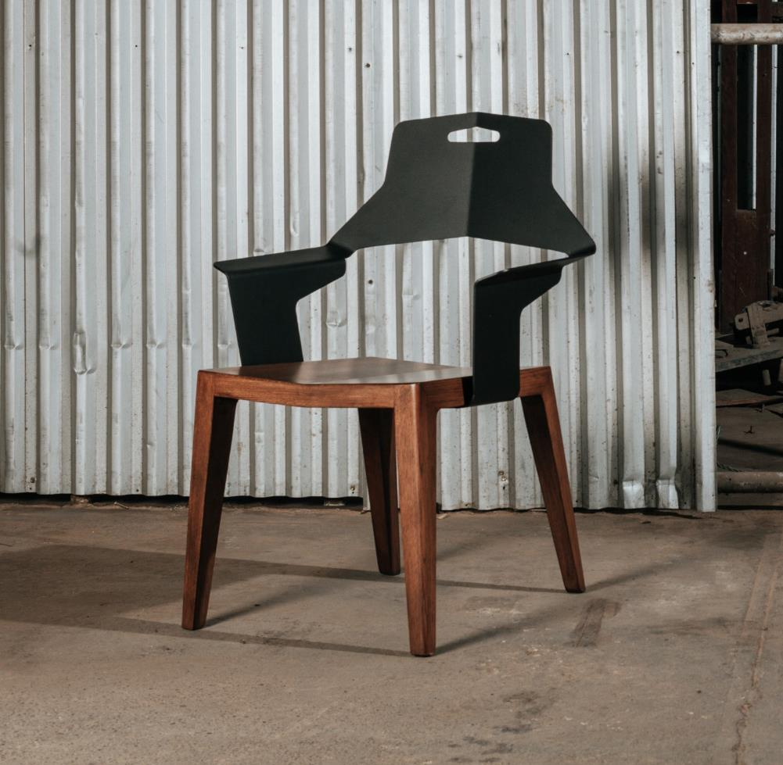
In Practice
INTERPRET DRAWINGS
Timber base: could be machined (but also could be made by hand)
Chair arms and back: 3mm laser cut and folded steel
The chair back is attached to base with timber screws

Slide 19
In Practice
INTERPRET DRAWINGS
So how do we turn a 3D part, into a 2D ‘flat pattern’ for laser cutting?
CAD software specifically designed for sheet materials allow us to ‘unfold’ our components into flat patterns for production.
Bend lines

Slide 20
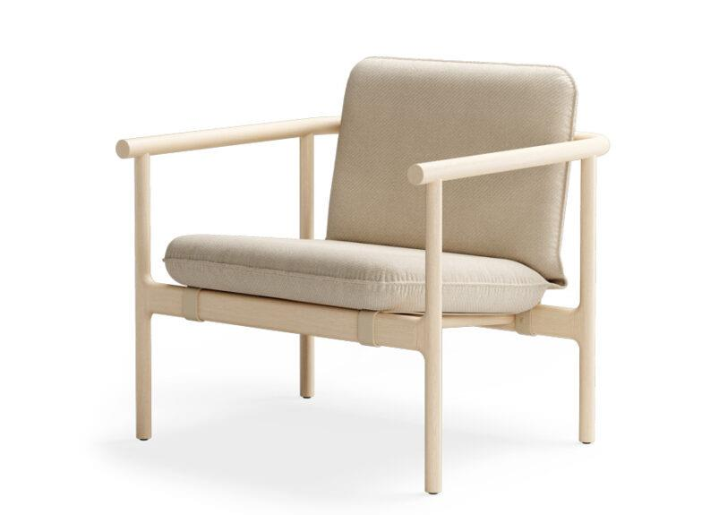
Reverse engineering furniture designs
ACTIVITY
Look at this Australian-made chair design and answer the following questions:
What are the processes that you can identify in the chair?
Where would you expect to see the chair?
What are the goals of the design?
‘Hoshi’ Chair by Tom Skeehan

Slide 21
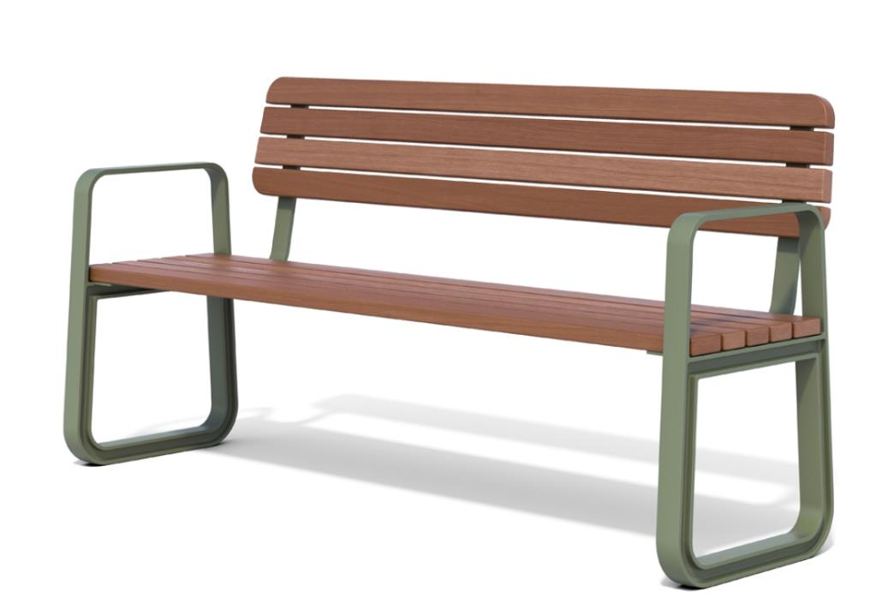
Reverse engineering furniture designs
ACTIVITY
Look at this Australian-made chair design and answer the following questions:
What are the processes that you can identify in the chair?
Where would you expect to see the chair?
What are the goals of the design?
‘Precinct’ Bench by Danielle Duvoisin

Slide 22
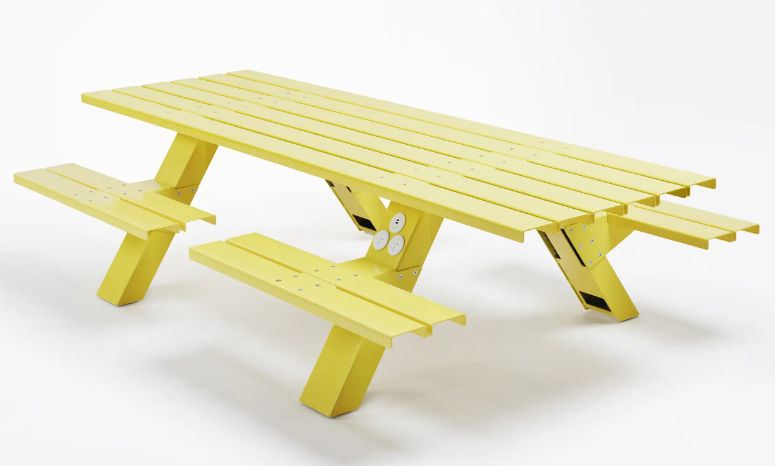
Reverse engineering furniture designs
ACTIVITY
Look at this Australian-made chair design and answer the following questions:
What are the processes that you can identify in the chair?
Where would you expect to see the chair?
What are the goals of the design?
‘Mass’ Bench and Table by Alexander Lotersztain

Slide 23
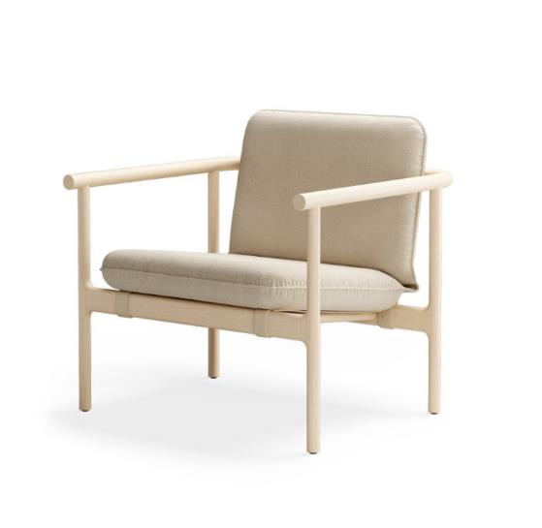
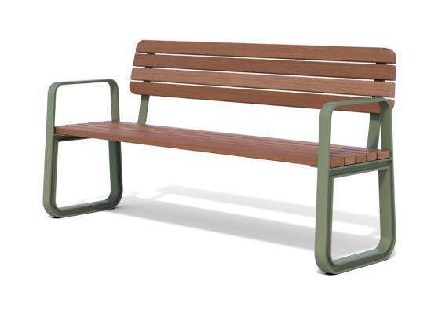
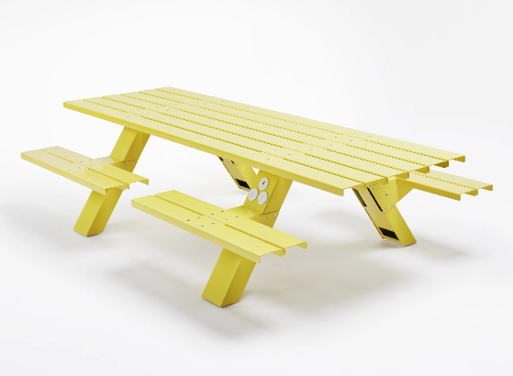
REVERSE ENGINEERING
What are the processes that you can identify in this item?
Where would you expect to see this item?
What are some of the goals of its design?

Slide 24

REVERSE ENGINEERING
Characterised by:
Luxury
Comfort
Texture
Is made using:
Machined timber
Upholstery
Characterised by
Weather endurance
Strength and Durability
Theft and vandalism deterrent
Is made using
Sand cast legs
Folded sheet-metal brackets
Solid timber slats
Characterised by
Endurance for public use
Can seat many people for a meal, party, picnic etc
Also can have charging accessories, good for public spaces like airports
Is made using
Sheet metal and fasteners

Slide 25

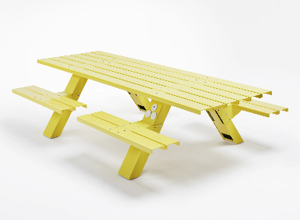



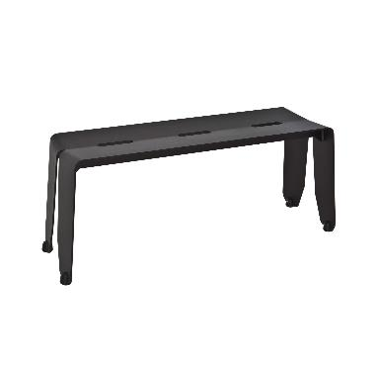

Summary and discussion
LESSON CONCLUSION
By looking back at all the chairs we’ve considered throughout the lesson, review and discuss the interplay between:
Design goals & functionality
Manufacturing methods
Aesthetics and ‘feel’

Slide 26

Consider your surroundings
HOMEWORK
We are surrounded by products that have been manufactured using these methods.
INSPIRATION
If you’re looking for some inspiration, look at Manufacturing Matters – a digital resource with almost 200 careers in manufacturing
Task | When you’re at home, observe the furniture and other products around you and see if you notice evidence of some of the processes we’ve learned about today.
Reflection | Why do you think those methods or processes were chosen? What goal were they trying to achieve, or what problem were they trying to solve?
Goal | Consider the range of possible manufacturing career options
manufacturingmatters.com.au

