Slide 1
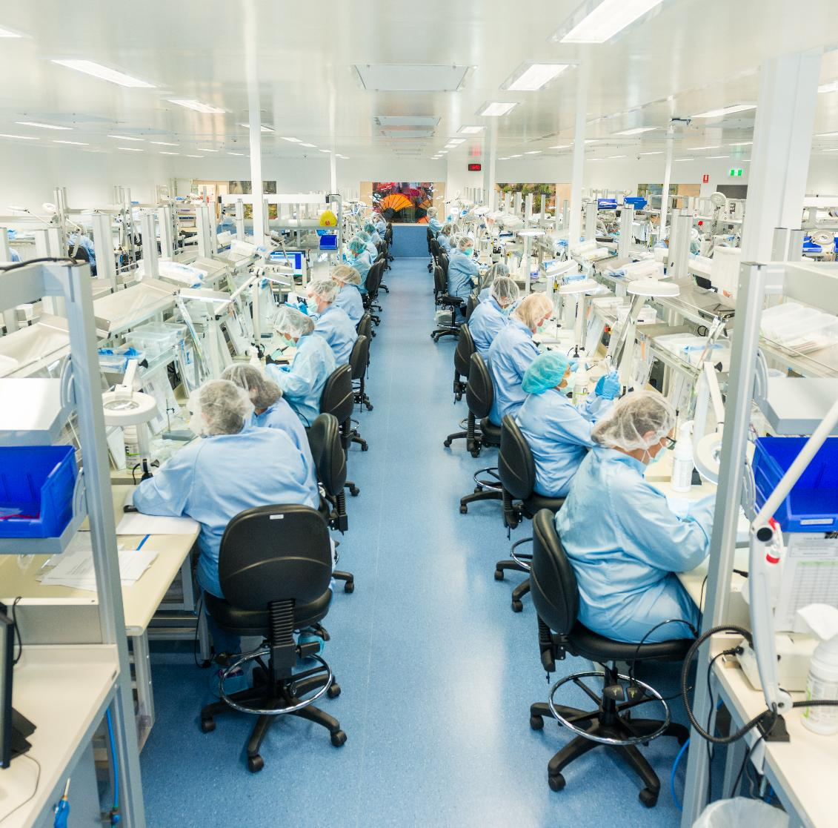



INNOVATIONS
LIFE-CHANGING
MEDICAL TECHNOLOGY MANUFACTURING
COOK MEDICAL AUSTRALIA

Slide 2
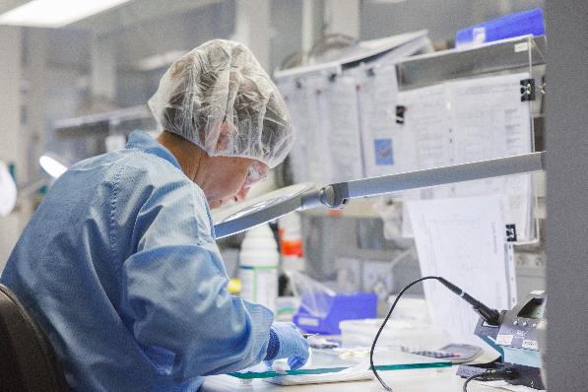
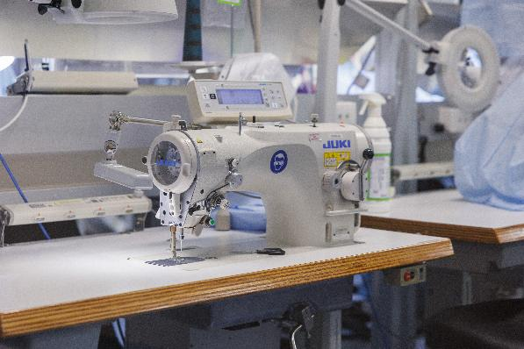
About Cook Medical Australia
EMPLOYER PROFILE
Established in 1979 in Victoria; relocated to Eight Mile Plains, Queensland in 1988
One of the first businesses to operate from Brisbane Technology Park
Family-owned global company creating quality medical products
One of Queensland’s largest medical device manufacturers and exporters
Over 800 employees in diverse roles across the organisation; more than 200 manufacturing employees
Products exported to 64 countries worldwide
Services nearly 60 clinical specialties globally
Contributing to revolutionary patient care through innovative medical devices
Strengthening Queensland’s reputation as a biomedical innovation hub
“Everything we do impacts someone’s life”
- Josh Griffin, Senior Manager, Manufacturing Operations

Slide 3
Medical Technology
INDUSTRY SUMMARY
Medical technology manufacturing represents a vital sector within Australia’s innovation economy, creating sophisticated devices that revolutionise patient care and treatment outcomes.
In Queensland, companies like Cook Medical exemplify the industry’s potential, designing and producing life-saving products that are exported to over 60 countries. The pharmaceutical and medical technology industries are worth approximately $6.7 billion to Australian economy annually.
This industry combines precision engineering with medical expertise to develop products that enable physicians to diagnose earlier, perform less invasive procedures, and deliver more effective treatments.
FAST FACTS
Pharmaceutical and medical technology industries are worth approximately $6.7 billion to Australian economy annually
The industry creates high-skilled jobs spanning engineering, quality assurance, regulatory affairs, and precision manufacturing
Medical devices undergo rigorous testing and validation, with many products requiring skilled hand-crafting that cannot be fully automated
Source: ABS (Australia Industry – Manufacturing, and Australian National Accounts: State Accounts – Queensland)

Slide 4
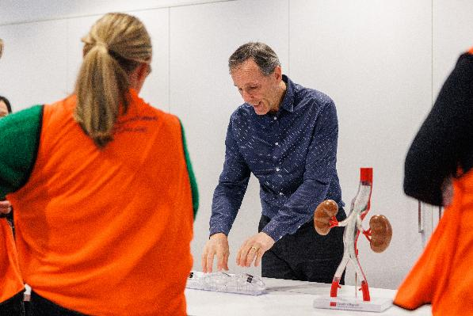
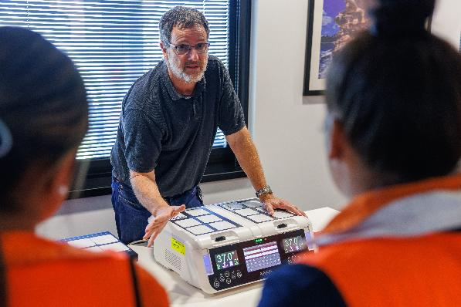
Manufactured in Queensland
INDUSTRY SUMMARY
Life-Changing Products Designed and Made in Australia
Endovascular Stent Grafts
Sophisticated grafts for treating life-threatening vascular diseases
Custom-made to fit each patient’s unique anatomy
Hand-sewn and hand-knotted with medical-grade polyester thread by skilled technicians
Developed in partnership with Perth-based vascular clinicians
IVF Products
Innovative fertility technologies expanding parenthood possibilities worldwide
Developed with pioneering fertility units in Melbourne and Sydney
Represents Australian innovation with global impact
DESIGN PRINCIPLES
Customer-centric design crafted to serve both patients and healthcare profession, close collaboration with physicians to address real clinical needs, focus on usability and intuitive design for high-pressure situations

Slide 5
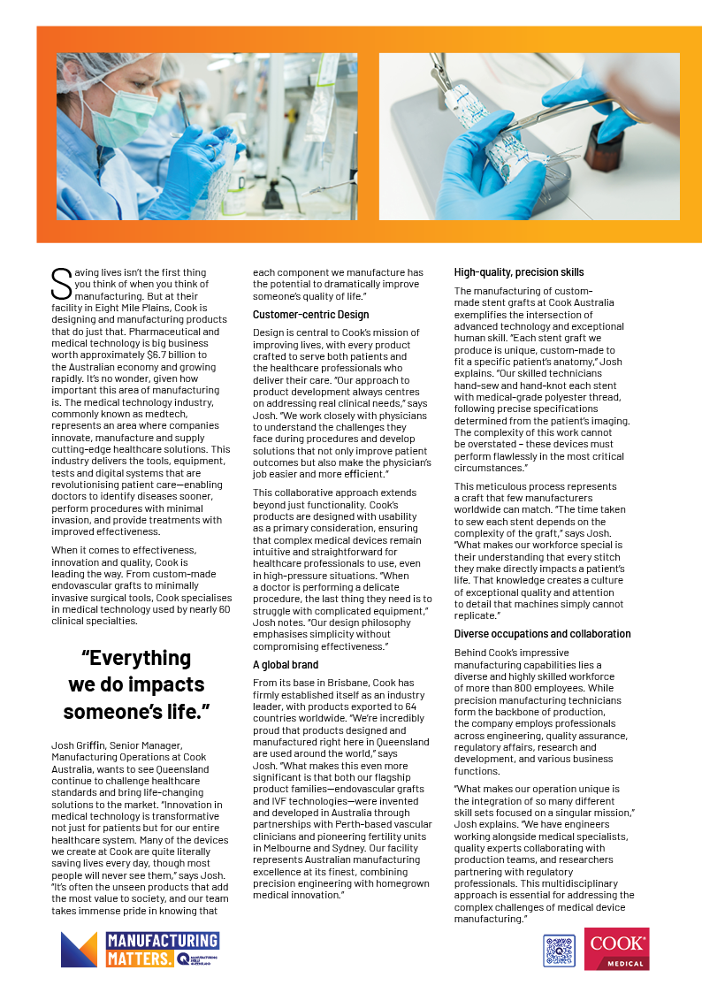
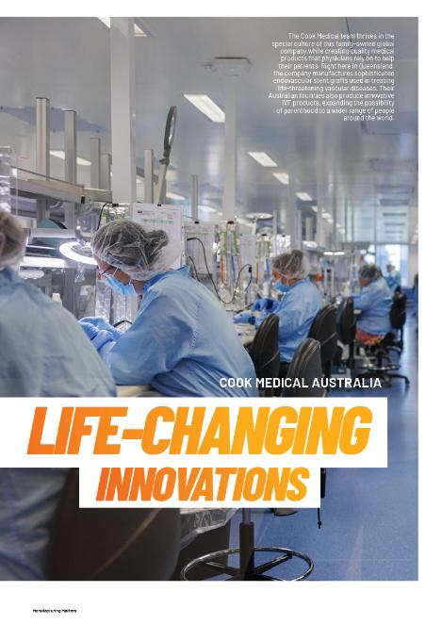
Life-changing innovations
Explore & Reflect
Activity Instructions:
Download the Cook Medical Australia case study from the Manufacturing Matters website
Read about their innovative approach to medical technology manufacturing
Reflect on the following questions:
Discussion Points:
Why are companies like Cook Medical so important to healthcare and the economy?
What specific medical technologies does Cook manufacture in Queensland?
What impact do these technologies have on patients worldwide?
What other medical technologies or devices can you think of?
How might these technologies require similar manufacturing skills?
https://manufacturingmatters.com.au/cook-medical-australia-precision-manufacturing-saving-lives

Slide 6
Medical Manufacturing Careers
COOK MEDICAL AUSTRALIA
Manufacturing Technician
Engineering Specialist
Quality Assurance
Job overview: Manufacturing technicians craft medical devices with meticulous attention to detail, ensuring each component meets exact specifications for patient use.
Key Duties: They operate specialised equipment to produce medical components according to strict quality standards and perform detailed hand-assembly of complex medical devices like stent grafts and surgical tools. They also conduct initial quality checks and maintain detailed production documentation essential for regulatory compliance.
Key Skills: Manual dexterity, attention to detail, ability to follow precise protocols, technical comprehension, quality focus, patience, basic understanding of medical terminology
Educational Pathway: Vocational Education and Training (Certificate III/IV in Manufacturing Technology or similar)
Job overview: Engineering Specialists design, develop, and improve medical devices and manufacturing processes to ensure optimal functionality, safety, and efficiency.
Key Duties: They create technical specifications and blueprints for new medical products while solving complex design challenges through innovative engineering solutions. They also collaborate with cross-functional teams to ensure manufacturability and regulatory compliance of designs.
Key Skills: Technical design expertise, problem-solving, 3D modelling, materials knowledge, analytical thinking, project management, regulatory awareness, CAD proficiency
Educational Pathway: Higher Education (Bachelor’s or Master’s degree in Biomedical, Mechanical, or Materials Engineering)
Job overview: Quality Assurance Professionals establish and maintain comprehensive quality management systems to ensure medical devices consistently meet safety standards and regulatory requirements.
Key Duties: They develop and implement testing protocols to verify product quality at various stages of manufacturing and conduct thorough documentation reviews to ensure compliance with international standards. They also lead quality investigations when deviations occur and coordinate regulatory audits.
Key Skills: Analytical thinking, attention to detail, knowledge of ISO standards, regulatory awareness, documentation expertise, problem-solving, statistical analysis, risk assessment
Educational Pathway: Higher Education or Vocational Education and Training (Bachelor’s degree in Science/Engineering or Diploma in Quality Management with relevant experience)

Slide 7
Medical Manufacturing Careers
COOK MEDICAL AUSTRALIA
Regulatory Affairs Manager
Research and Development Scientist
Business Operations and Support
Job overview: Regulatory Affairs Experts navigate the complex landscape of medical device regulations to ensure products meet all legal requirements for market approval worldwide.
Key Duties: They prepare and submit comprehensive documentation packages to regulatory bodies like the TGA and FDA to obtain and maintain product approvals. They also monitor changing regulations across global markets and advise internal teams on compliance requirements throughout the product lifecycle.
Key Skills: Regulatory knowledge, analytical thinking, attention to detail, technical writing, project management, negotiation skills, cross-cultural communication, legal interpretation
Educational Pathway: Higher Education (Bachelor’s or Master’s degree in Science, Engineering, or Law with specialised regulatory affairs training)
Job overview: Research and Development Scientists drive innovation by conceptualising, designing, and testing new medical technologies that address unmet clinical needs.
Key Duties: They conduct extensive research to identify opportunities for new medical device development and perform systematic testing of materials, designs, and prototypes to validate concepts. They also collaborate with physicians and engineers to translate clinical needs into viable product specifications.
Key Skills: Scientific method expertise, creative problem-solving, technical knowledge, research skills, analytical thinking, innovation mindset, collaborative approach, clinical awareness
Educational Pathway: Higher Education (Master’s or PhD in Biomedical Science, Materials Science, or related field)
Job overview: Business Operations professionals provide essential support services that enable the core manufacturing functions to operate efficiently while ensuring commercial success.
Key Duties: They manage diverse business aspects from supply chain logistics and customer relations to financial planning and human resources development. They also coordinate between departments to optimise workflow and support the overall business strategy in the highly specialised medical device market.
Key Skills: Business acumen, communication skills, organisational abilities, problem-solving, adaptability, industry knowledge, project management, stakeholder management
Educational Pathway: All from Direct Entry to Higher Education (pathways vary widely from Certificate IV to Bachelor’s degrees in Business, Commerce, Supply Chain, or specialised fields depending on specific role)

Slide 8
MEDICAL TECHNOLOGY
ACTIVITY
PURPOSE, PROCESS, SKILLS
Task | Your task is to explore one medical technology product manufactured by Cook Medical Australia (https://www.cookmedical.com.au) and find information on: Product purpose and patient impact Manufacturing processes involved Careers/skills that contribute to its development and production
Reflection | What aspects of creating this medical product would you find most interesting to be involved with and why? Is there sufficient information about this product to understand the career pathways involved in its creation? Why or why not? What are they? What skills might be required to design and manufacture this product?
Goal | This activity aims to help you understand how medical products manufactured in Queensland require various skills and career paths to bring them from concept to patient care.
Task instructions
Step 1 | Step 1: Select One Product (1 minute) Choose one product from Cook Medical Australia’s Endovascular Product Line: Custom-made stent grafts Endovascular delivery systems
Step 2 | Step 2: Research (5 minutes) Use the information about Cook Medical Australia to complete the following: Medical purpose of this product How it improves patient outcomes Key manufacturing processes required Technical skills needed to produce it Careers involved in its development and production Where in the world this product is used
Step 3 | Step 3: Reflect (5 minutes) Choose two of the reflection questions to answer.

Slide 9

Manufacturing Skills Queensland gratefully acknowledges Cook Medical Australia for providing valuable information and photography for this case study. Their willingness to share insights into their innovative medical technology manufacturing processes has enriched this educational resource. The real-world examples of precision manufacturing and career pathways showcased through Cook Medical's Queensland operations offer students authentic perspectives on opportunities in manufacturing.

Slide 10
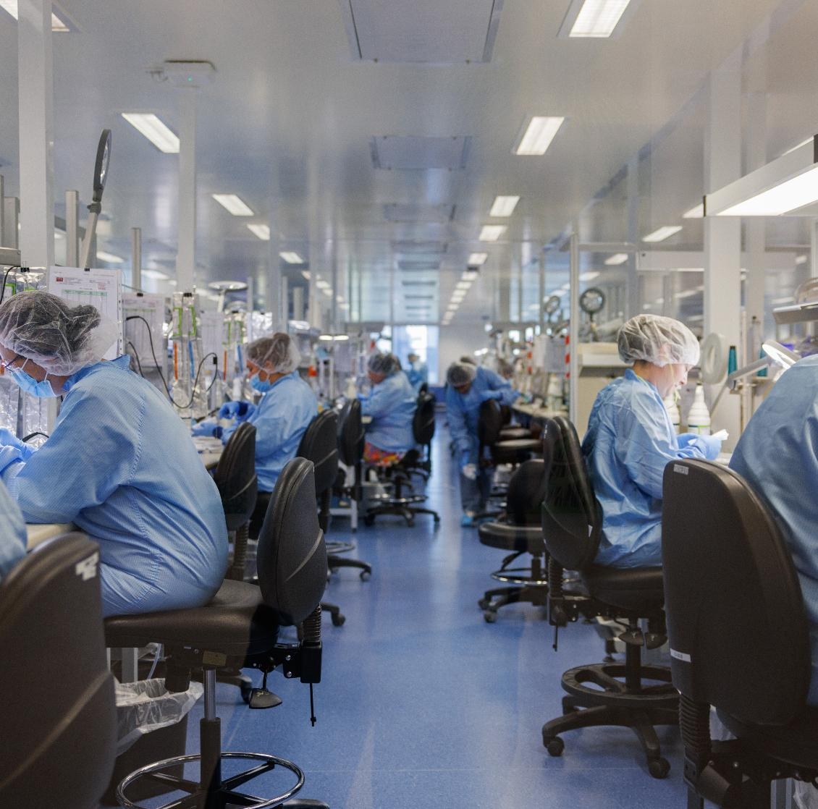
INNOVATIONS
LIFE-CHANGING
MEDICAL TECHNOLOGY MANUFACTURING
COOK MEDICAL AUSTRALIA

